Slide 1
Finding Balance in Field Experience:
Designing Action-Oriented “Lab Sites” Through College-District Collaboration
Sarah Dunlap – Director of Field, Assessment, and Candidate Engagement,
The College of Wooster
Ryan Ozar – Associate Professor, Department of Education, The College of Wooster
Matthew Broda – Associate Professor, Department of Education, The College of Wooster
Molly Richard – Director of Curriculum and Instruction, Wooster City Schools
Fall 2026 OCTEO Conference

Slide 2
Tell a story.
Share our practice.
Ask others to share practices.
Spark solutions/innovations.
Make friends?
Our GOALS for today:

Slide 3
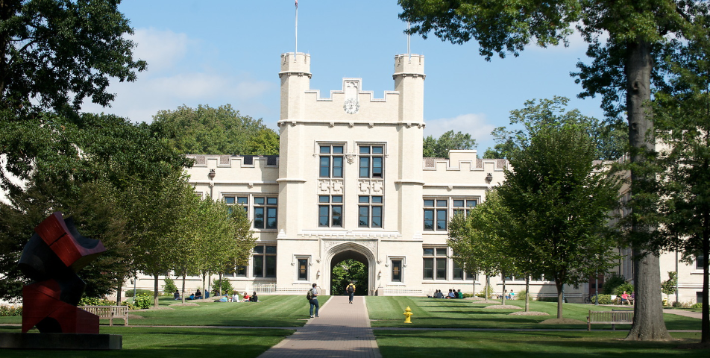
The College of Wooster Education Program – Field Experience At-a-Glance
Total enrollment = ~1300
Education Program majors = ~ 80 annually
Field experience in local county schools, quite regularly in Wooster City Schools:
  4 elementary
  1 middle
  1 high
AYA licensure candidates = ~ 15 annually

Slide 4
Wooster AYA, Field Progression At-a-Glance
The course with a field or clinical experience | Group, individual or clinical | # of hours in the field/ clinical | Length of time in the field/ clinical | When a course is typically taken | Nature of the placement
EDUC10000 | Individual | 32 hours | 8 weeks | First or Soph. year | Typically the first placement Placements attempted to be consistent with the content area
EDUC11500 | Group | 6 Hours | 3 days | First or Soph. year | College group visits to Preschool, Elementary, Middle School and High School settings
EDUC12000 | Group | 8 hours | 2-3 visits | Soph. or Jr. year | Focused field observing reading environments in 7-12 schools and ESL tutoring in the local Family learning center
EDUC 17000 | Individual | 21 hours | 7 weeks | First or Soph. year | Intervention Settings
EDUC25100 | Individual and/or partner | 50 hours | 8 weeks | Soph. or Jr. year | 7-12 classroom, different from a previous placement/ consistent with content area
EDUC30000 | Group | 8 hours | 5 weeks | Sr. year | Shadow a professional for five weeks
EDUC32000 | Individual | 50 hours | 8 weeks | Jr. or Sr. year | 7-12 classroom, different from a previous placement/ specific content methods course consistent with content area
EDUC 49300 49400 49500 | Clinical | 480 hours | 13 weeks | Sr. yr. or as postgraduate | 7-12 classroom different from previous field placements (whenever possible)
TOTALS |  |  |  | 189 field hours 480 clinical hours

Slide 5
IS this what you see?
Movement of teachers and students
0
Grade level

Slide 6
How to find a balance of more purposeful observation and demonstration/action?

Slide 7
“Lab sites” idea development
Shared concerns about field with district partners
  District leader outlined “lab sites” concept
    District and college folks identified host school
      Principal accepted opportunity
        Ran a pilot for intro AYA methods
          Expanded to advanced AYA methods
            Into third year of mutually shared success

Slide 8
Key elements of lab sites model
Purposeful Schedule
Separation of Observation / Action
Observation Notes
Group Reflection / Debrief Meetings

Slide 9
Overall Field schedule – EDUC 251
Monday | Tuesday | Wednesday | Thursday | Friday
 |  |  | 9/17 CoW students visit Edgewood
9/21 Lab Sites | 9/22 Lab Sites | 9/23 Lab Sites | 9/24 Lab Sites | 9/25 Debrief at Edgewood
9/28 Lab Sites | 9/29 Lab Sites | 9/30 Lab Sites | 10/1 Lab Sites | 10/2 Debrief at Edgewood
10/5 COW Fall Break | 10/6 COW Fall Break | 10/7 COW Fall Break | 10/8 COW Fall Break | 10/9 COW Fall Break
10/12 Intensives | 10/13 Intensives | 10/14 Intensives | 10/15 Intensives | 10/16 Debrief at COW
10/19 Intensives | 10/20 Intensives | 10/21 Intensives | 10/22 Intensives | 10/23 Debrief at COW
10/26 Intensives | 10/27 Intensives | 10/28 Intensives | 10/29 Intensives | 10/30 Debrief at COW
11/2 Intensives | 11/3 Intensives | 11/4 Intensives | 11/5 Intensives | 11/6 Debrief at COW
11/9 Intensives | 11/10 Intensives | 11/11 Intensives | 11/12 Intensives | 11/13 Debrief at COW
11/16 Intensives | 11/17 Intensives | 11/18 Intensives | 11/19 Intensives | 11/20 Debrief at COW
11/23 Intensives | 11/24 Intensives - Last Day! | 11/25 NO SCHOOL | 11/26 NO SCHOOL | 11/27 NO SCHOOL

Slide 10
Lab Sites schedule
Dates | Times | Group A: | Group B: | Group C: | Group D: | Group E:
Mon & Tues September 21 & 22 | 1st Period 7:50 - 8:32 | Mr. O - 5th Math Rm 108 | Mrs. V - 5th SS/Science Rm 110 | Ms. Va - 5th SS/Science - Rm 115 | Ms. S - 6th ELA - Rm 134 | Mr. L - 6th Math Rm 132
 | 2nd Period 8:35 - 9:15 | Mrs. H - 7th SS Rm 316 | Mrs. H - 7th Science - Rm 300 | Mrs. D - 7th Math Rm 302 | Mrs. F - 7th Math - Rm 315 | Mrs. T - 6th Math - Rm 214
Wed & Thurs September 23 & 24 | 1st Period 7:50 - 8:32 | Mr. L - 6th Math Rm 132 | Mr. O - 5th Math Rm 108 | Mrs. V - 5th SS/Science Rm 110 | Ms. Va - 5th SS/Science - Rm 115 | Ms. S - 6th ELA - Rm 134
 | 2nd Period 8:35 - 9:15 | Mrs. T - 6th Math - Rm 214 | Mrs. H - 7th SS Rm 316 | Mrs. H - 7th Science - Rm 300 | Mrs. D - 7th Math Rm 302 | Mrs. F - 7th Math - Rm 315
Mon & Tues September 28 & 29 | 1st Period 7:50 - 8:32 | Ms. S - 6th ELA - Rm 134 | Mr. L - 6th Math Rm 132 | Mr. O - 5th Math Rm 108 | Mrs. V - 5th SS/Science Rm 110 | Ms. Va - 5th SS/Science - Rm 115
 | 2nd Period 8:35 - 9:15 | Mrs. F - 7th Math - Rm 315 | Mrs. T - 6th Math - Rm 214 | Mrs. H - 7th SS Rm 316 | Mrs. H - 7th Science - Rm 300 | Mrs. D - 7th Math Rm 302
Wed & Thurs Sep 30 & Oct 1 | 1st Period 7:50 - 8:32 | Ms. Va - 5th SS/Science - Rm 115 | Ms. S - 6th ELA - Rm 134 | Mr. L - 6th Math Rm 132 | Mr. O - 5th Math Rm 108 | Mrs. V - 5th SS/Science Rm 110
 | 2nd Period 8:35 - 9:15 | Mrs. D - 7th Math Rm 302 | Mrs. F - 7th Math - Rm 315 | Mrs. T - 6th Math - Rm 214 | Mrs. H - 7th SS Rm 316 | Mrs. H - 7th Science - Rm 300

Slide 11
OBSERVATION SHEET TOPICS / PROMPTS
Observe what a teacher says and does in 15 minutes time
Track the movement and behavior of two students
Identify classroom management techniques
Identify social-emotional learning engagement
Document teachers’ interpersonal and communicative competencies
Capturing juicy quotes from teachers or students

Slide 12
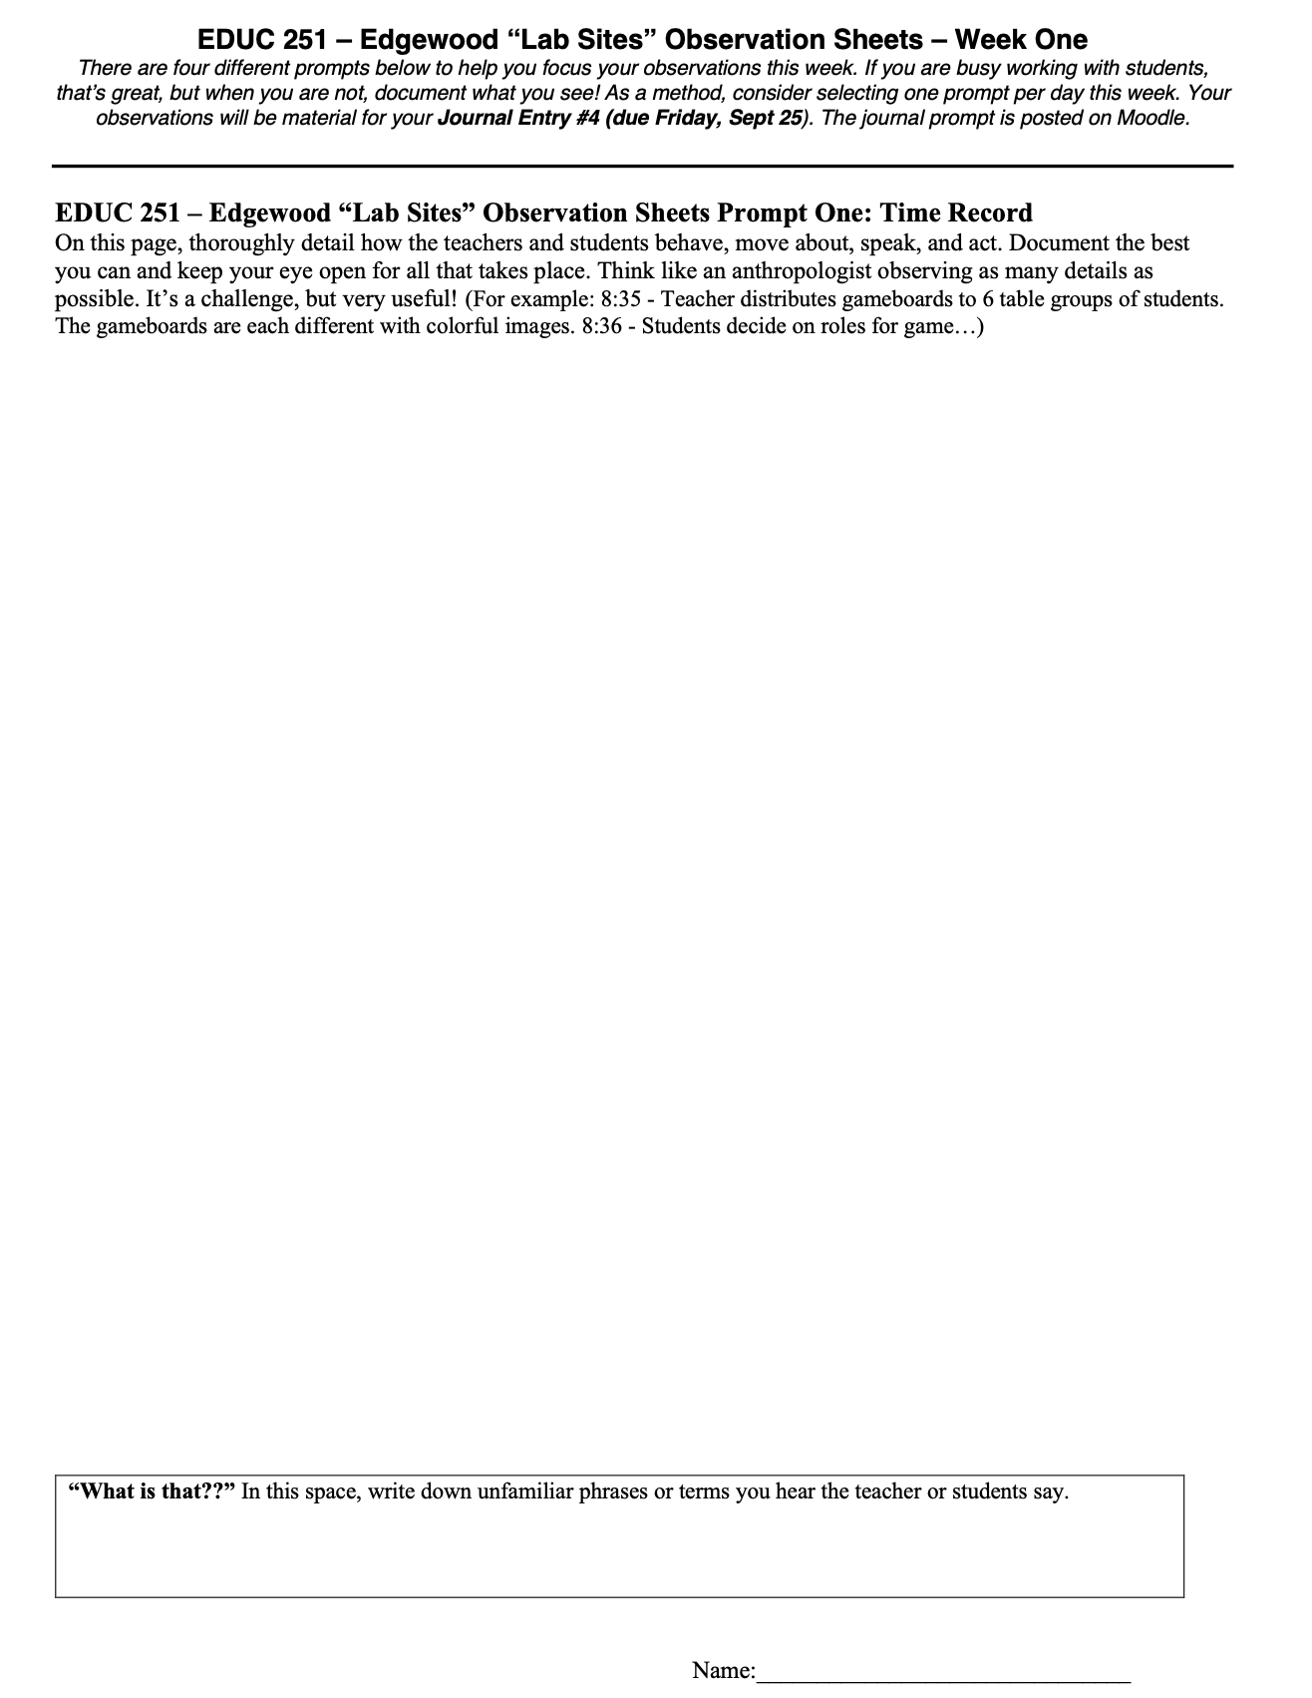
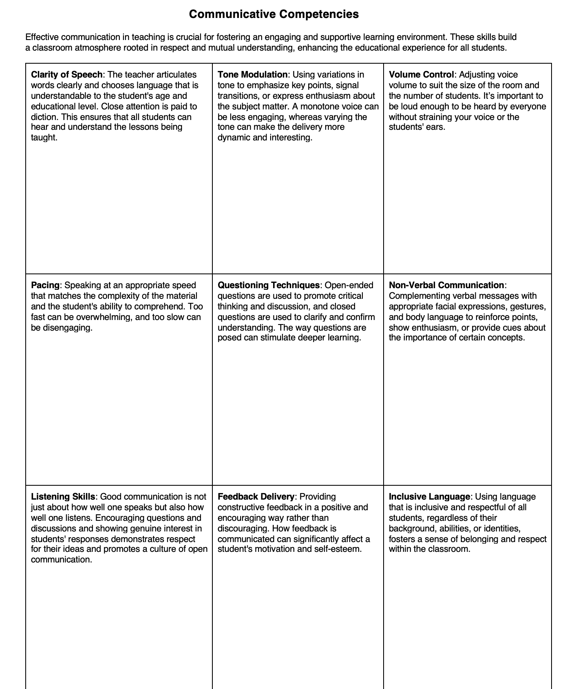
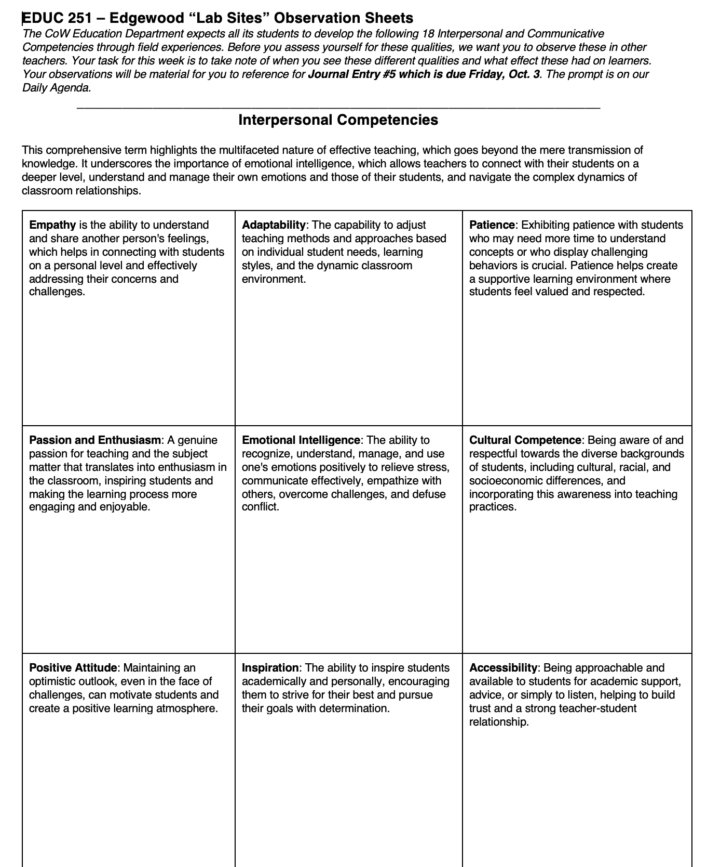
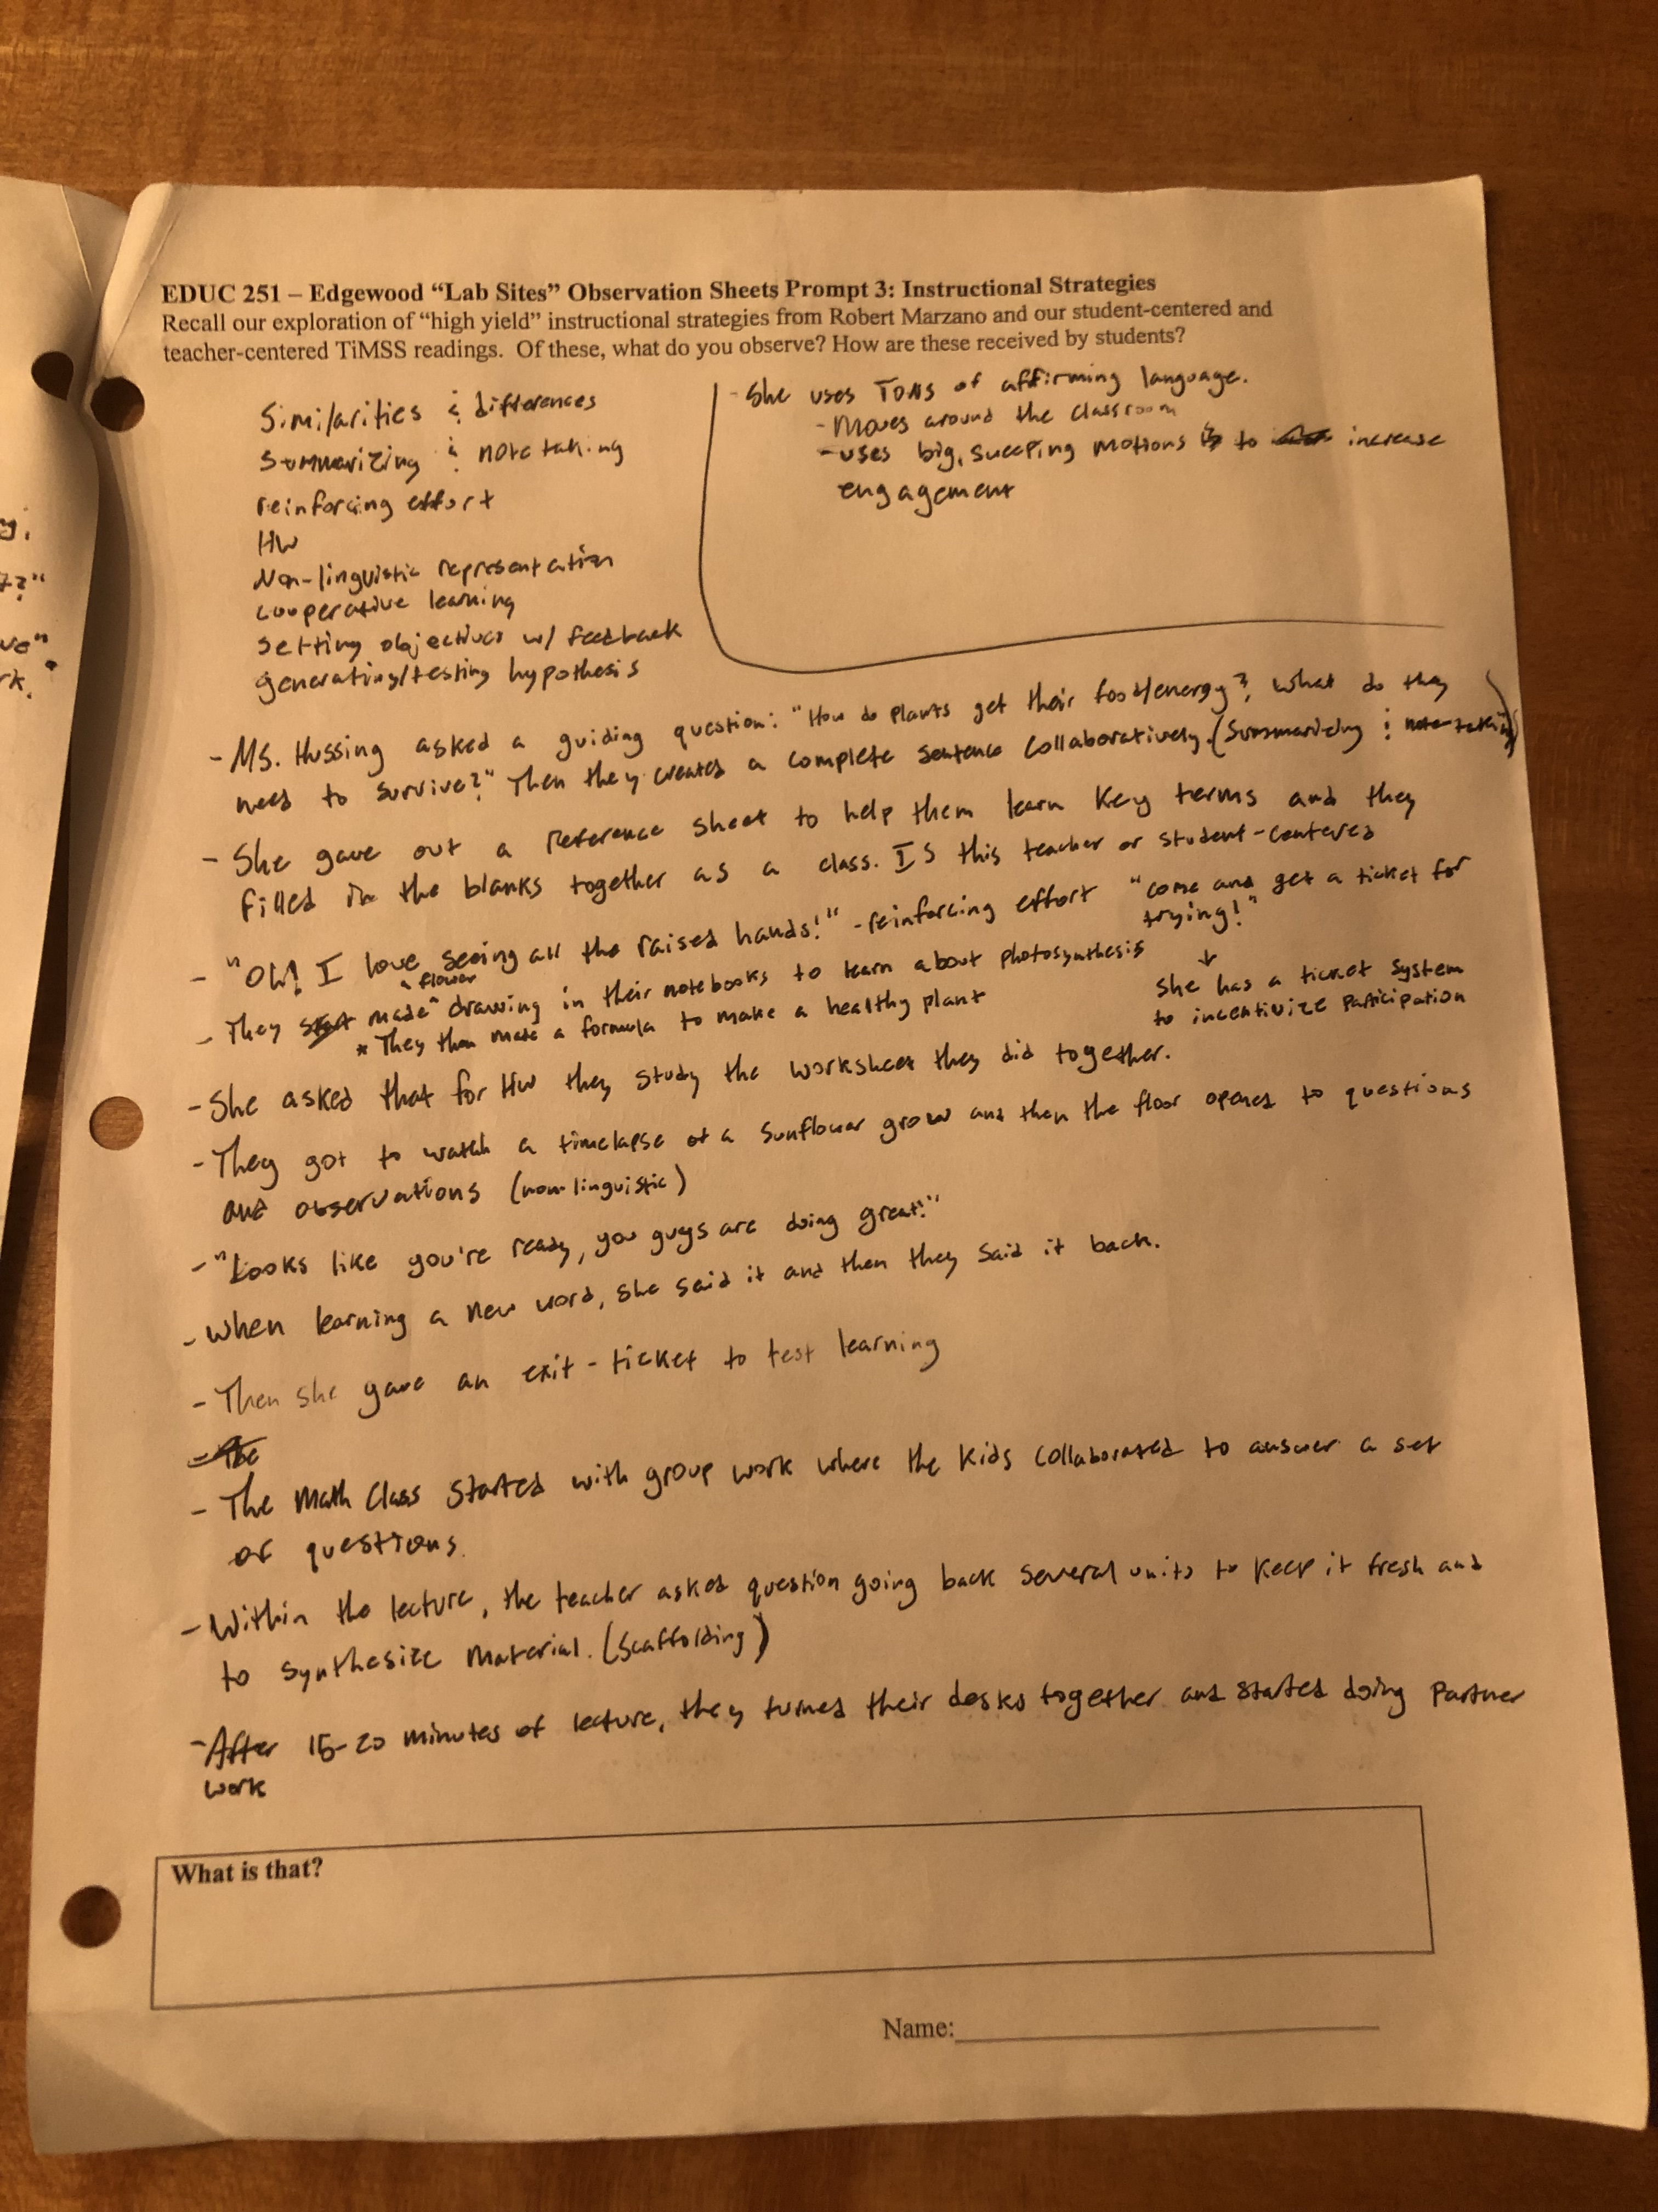

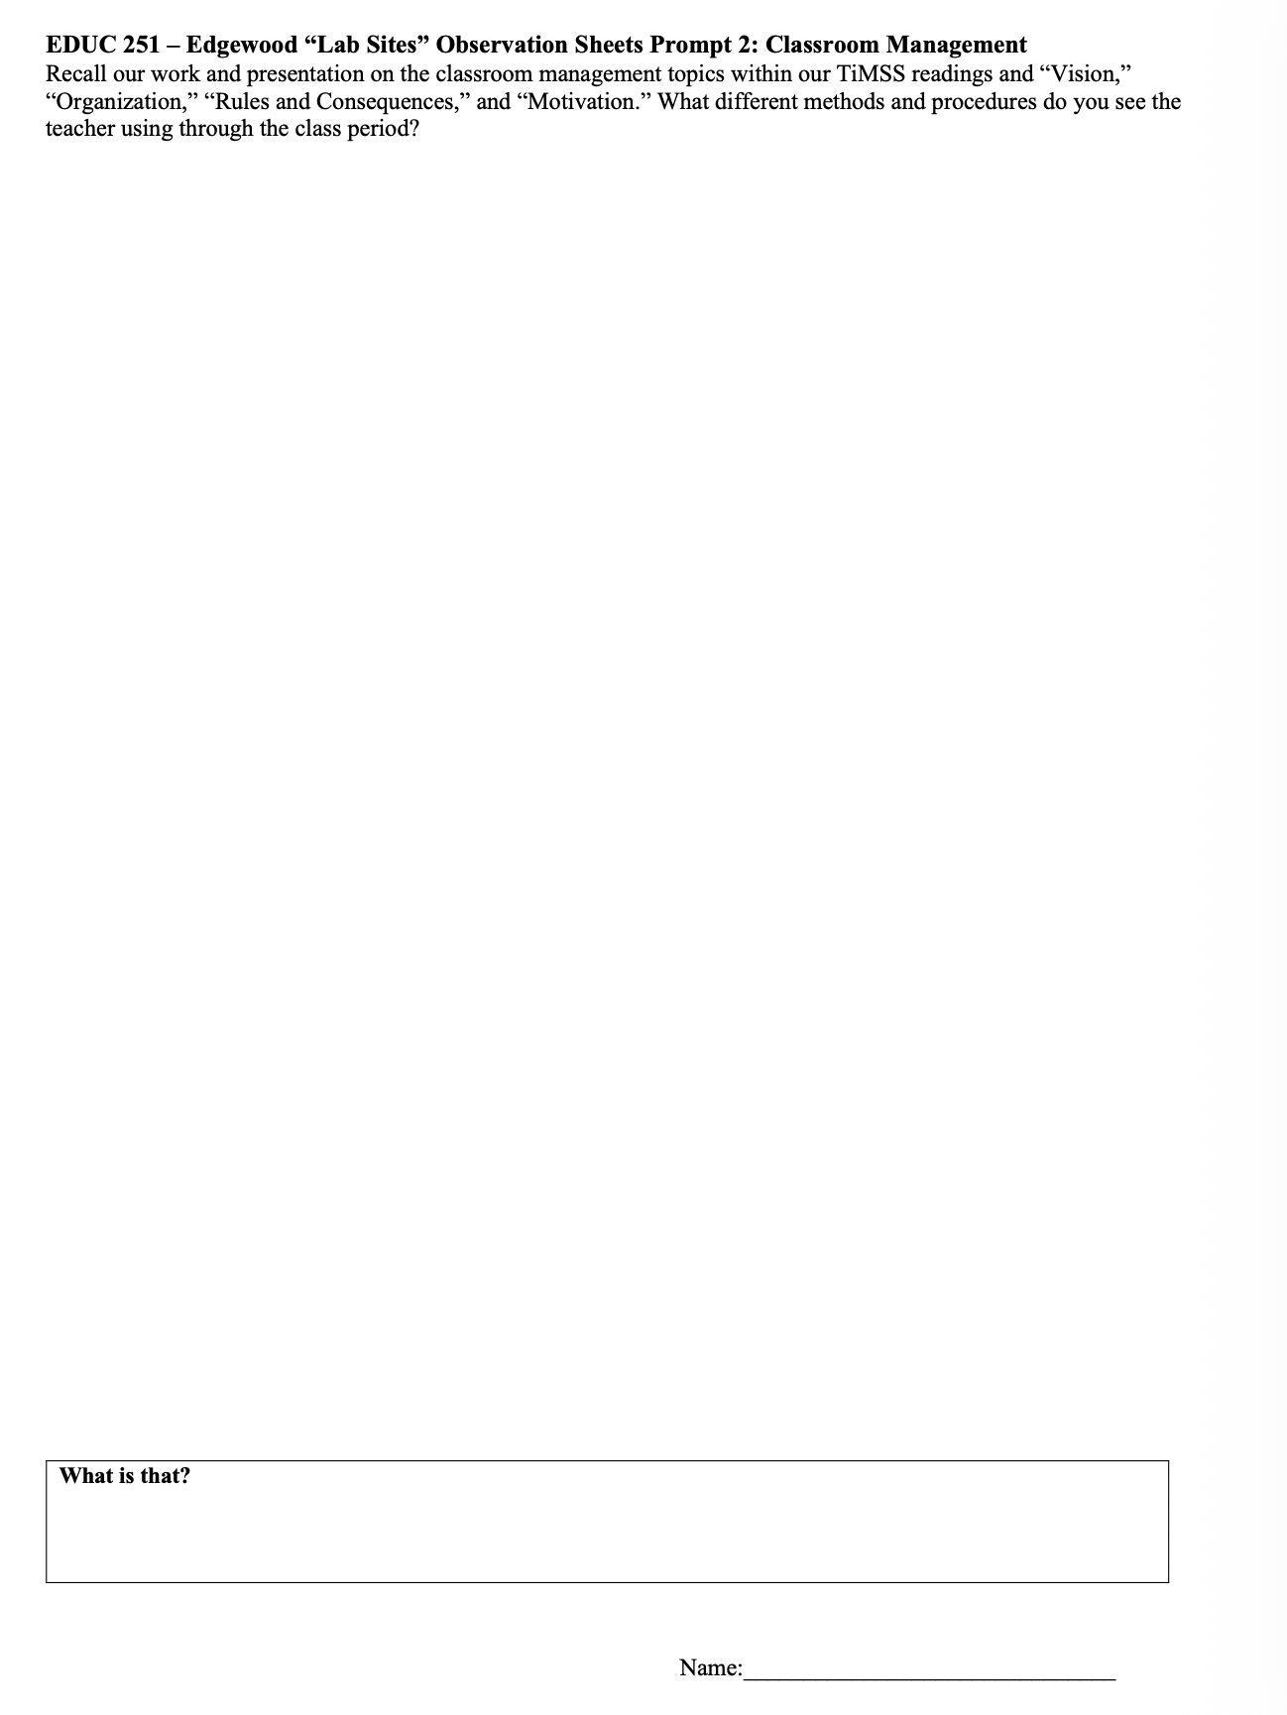
OBSERVATION SHEET TOPICS / GUIDELINES

Slide 13
And what about you?
How are you making field experiences more valuable for your students?
How are the solutions mutually beneficial to all partners?

Slide 14
Questions?
Sarah Dunlap - sadunlap@wooster.edu
Ryan Ozar – rozar@wooster.edu

